Slide 1
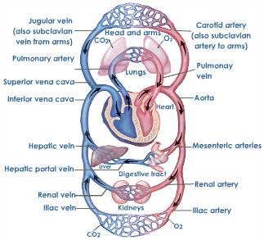
The Circulatory System
Chapter 18 & 19

Slide 2
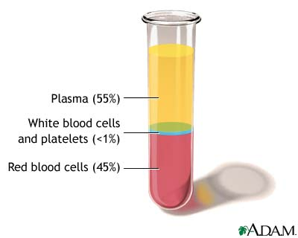
Blood and Blood Vessels-
Blood= 55% plasma
=90% H₂O, 7% proteins, 3% dissolved salts, etc.
45% formed elements
= rbc’s (~98%), wbc’s, and platelets

Slide 3
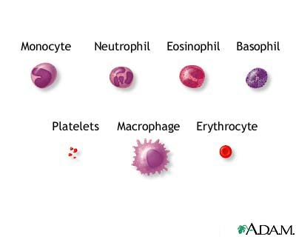
-RBC’s (erythrocytes) – contain hemoglobin that carries O₂ to cells and CO₂ away
-WBC’s (leukocytes) – 5 types all involved in fighting infection
-platelets – (thrombocyte cell fragments) not living, responsible for clotting

Slide 4
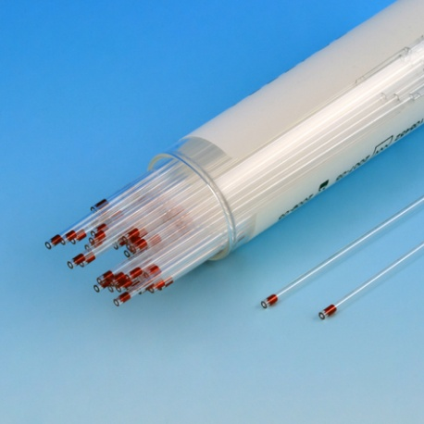
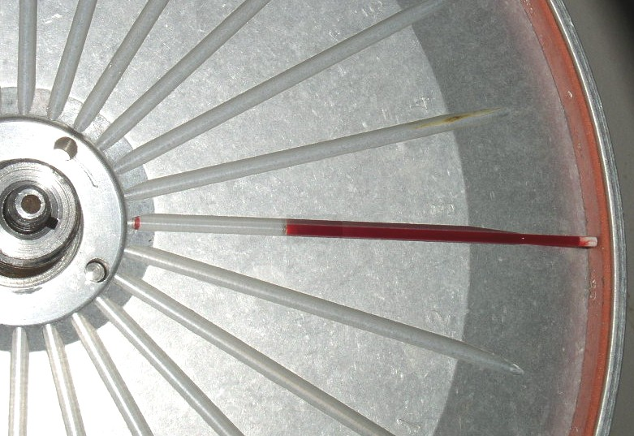
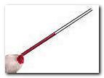
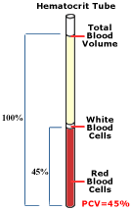
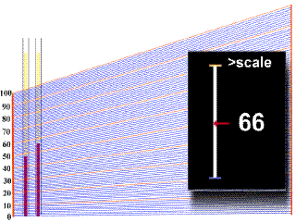
Basic tests for blood make-up:
Hematocrit- spin down blood to see % of RBCs
Low=anemia High=polycythemia

Slide 5
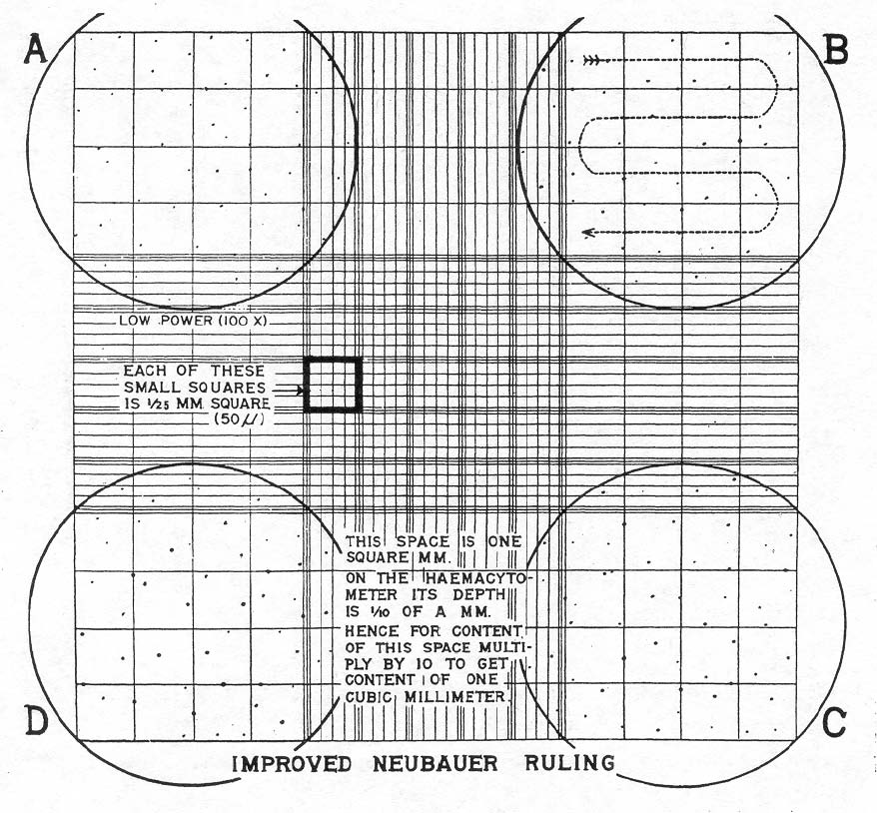
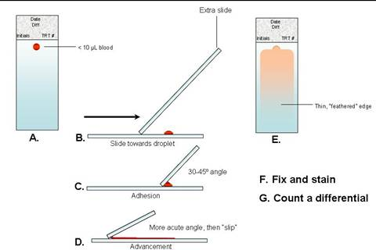
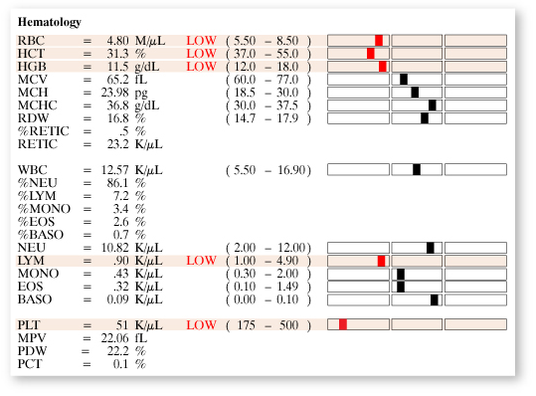
Complete blood count with differential (CBC w/ Diff.) – observation of # and type of cells in a sample
2.
1.
3.

Slide 6
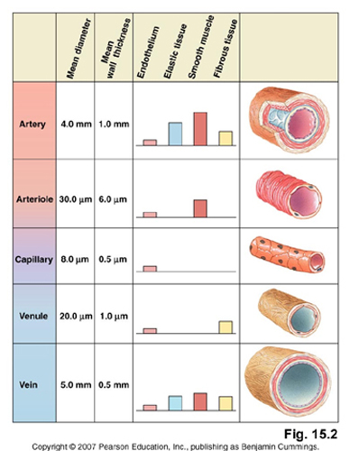
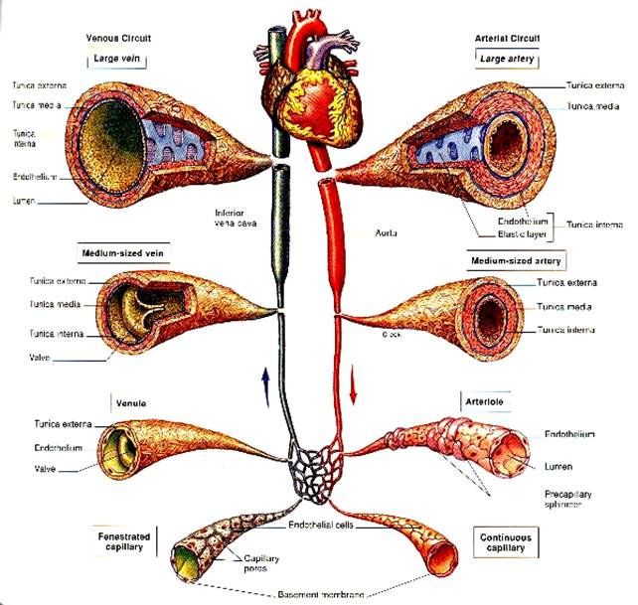
Blood Vessels Types:
Aorta
Arteries
Arterioles
Capillaries
Venules
Veins
Vena cava

Slide 7
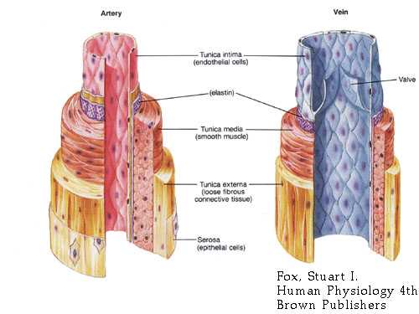
Arteries= AWAY from heart - high pressure - “elastic”
Veins= carry blood TO heart - low pressure - have valves to keep blood from reversing

Slide 8
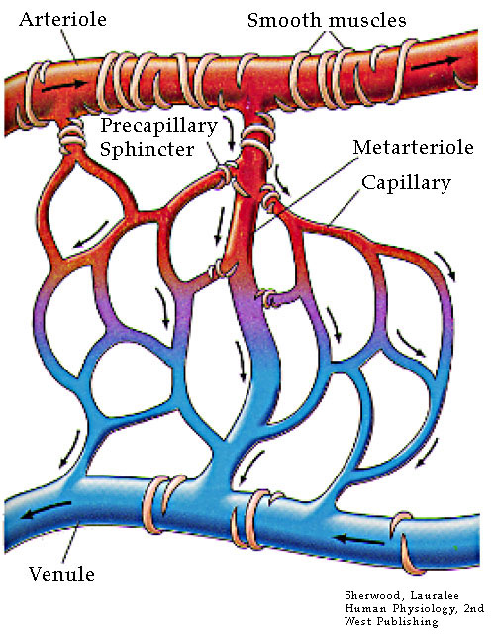
Capillaries= TINY vessels (wall is 1 cell thick)
-where gases (O₂ & CO₂) and materials are exchanged with tissues
- transition between arterial and venous circulation

Slide 9
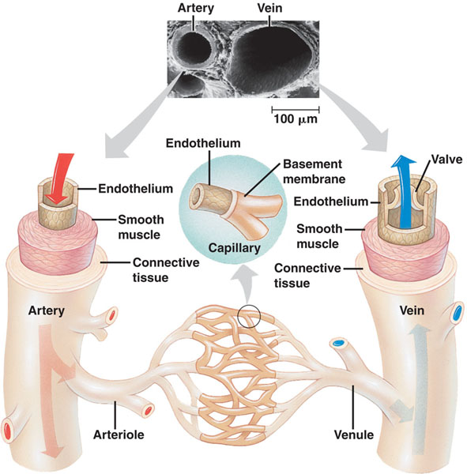
Comparison of Arteries and Veins:
Arteries | Veins
Thick walled | Thinner walls
Generally Larger Diameter | Slightly smaller diameter
Deep | Superficial (closer to skin)
Much smooth muscle | Less muscle
Quite elastic | Less elastic
No valves | Valves

Slide 10
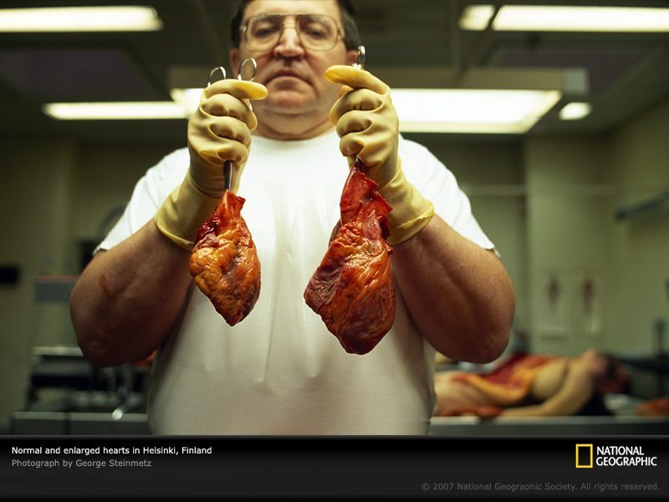
Anatomy of the Heart

Slide 11
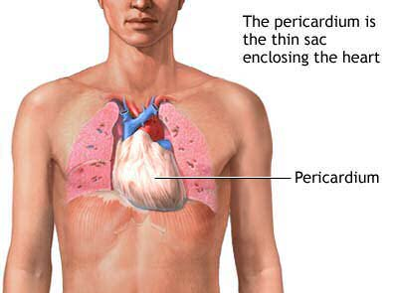
Pericardium- A tough double walled sac that surrounds the heart.
Protects the heart
Keeps heart from overfilling
Fluid between layers of pericardium allow for nearly friction free movement

Slide 12
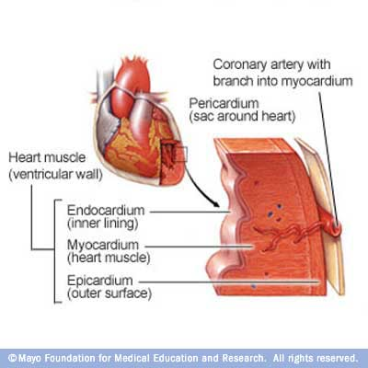
Coronary Vessels- on the outside of the heart and bring blood to/from heart muscle
Myocardium- the actual muscle of the heart
Endocardium- the inner epithelial lining of the heart chambers

Slide 13
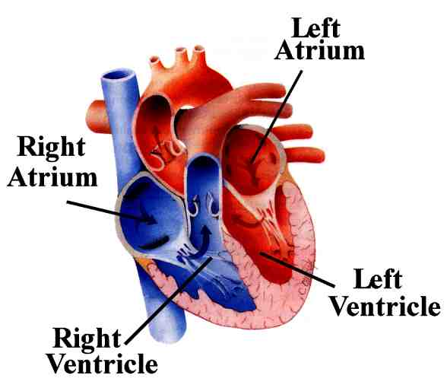
Heart Chambers
Left and right atrium (atria)- small upper chambers receiving blood to the heart.
Left= from pulmonary vein Right= from vena cava
Left and right ventricle(s)- large muscular chambers pushing blood out of the heart.
Left= to body via the aorta right= to lungs via pulmonary artery

Slide 14
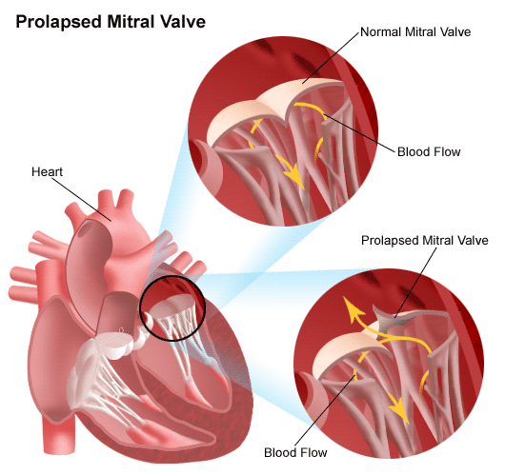
Heart Valves- allow blood flow in only 1 direction
AV (atrioventricular) valves= between atria and ventricles
Right AV= tricuspid valve left AV= mitral valve
Attached to small papillary muscles via the chordae tendinae (“heartstrings”) that help pull them CLOSED when the ventricles squeeze

Slide 15
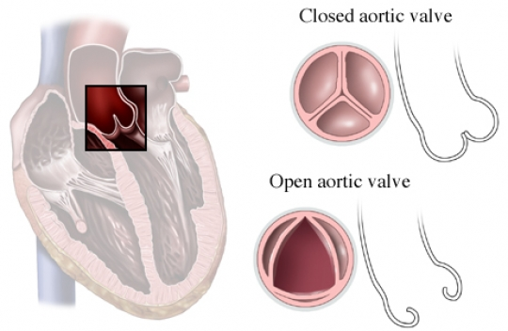
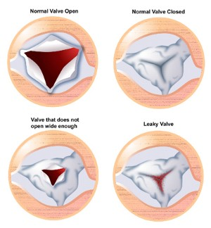
Semilunar valves= (semi-moon shape)
Left= aortic right= pulmonary
OPEN when ventricles squeeze to let blood out

Slide 16
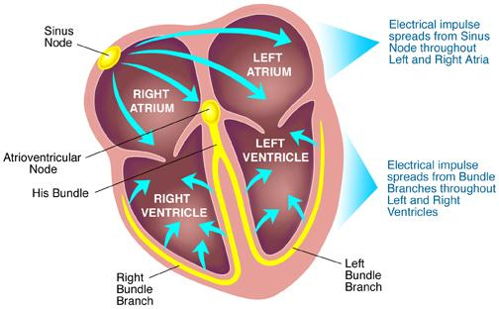
Conduction System of the Heart-
-Heart beat is intrinsic meaning no signal from the brain is actually needed!
Heart muscle cells will contract by themselves, when together they start to contract at the same time.
However, nerve and hormonal signals do alter its rate

Slide 17
4 main parts to the heart’s electrical system:
Sinoatrial or SA node-
Heartbeat starts here in upper Rt atrium (the hearts pacemaker)
Causes the atria to contract
SA Node

Slide 18
AV (atrioventricular node)- in center of heart
After atria contract completely, this controls contraction of ventricles.
AV Node

Slide 19
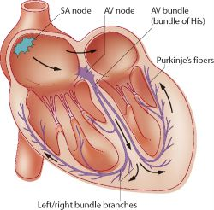
“Bundle of His” and 4. Purkinje fibers
Transmit the stimulus to the both ventricles so they contract simultaneously
Bundle of His
Purkinje Fibers

Slide 20
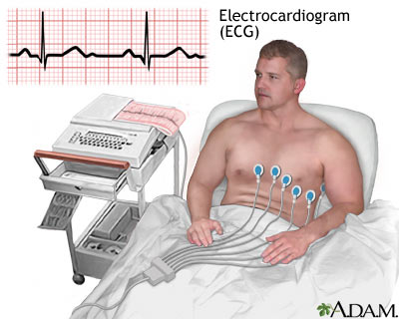
Electrocardiogram (ECG)-
A graphic record of the heart’s electrical activity
electrodes on the skin sense the movement of electric signal through the heart during heartbeat
only need 3 electrodes but 12 are used for best quality ECG

Slide 21
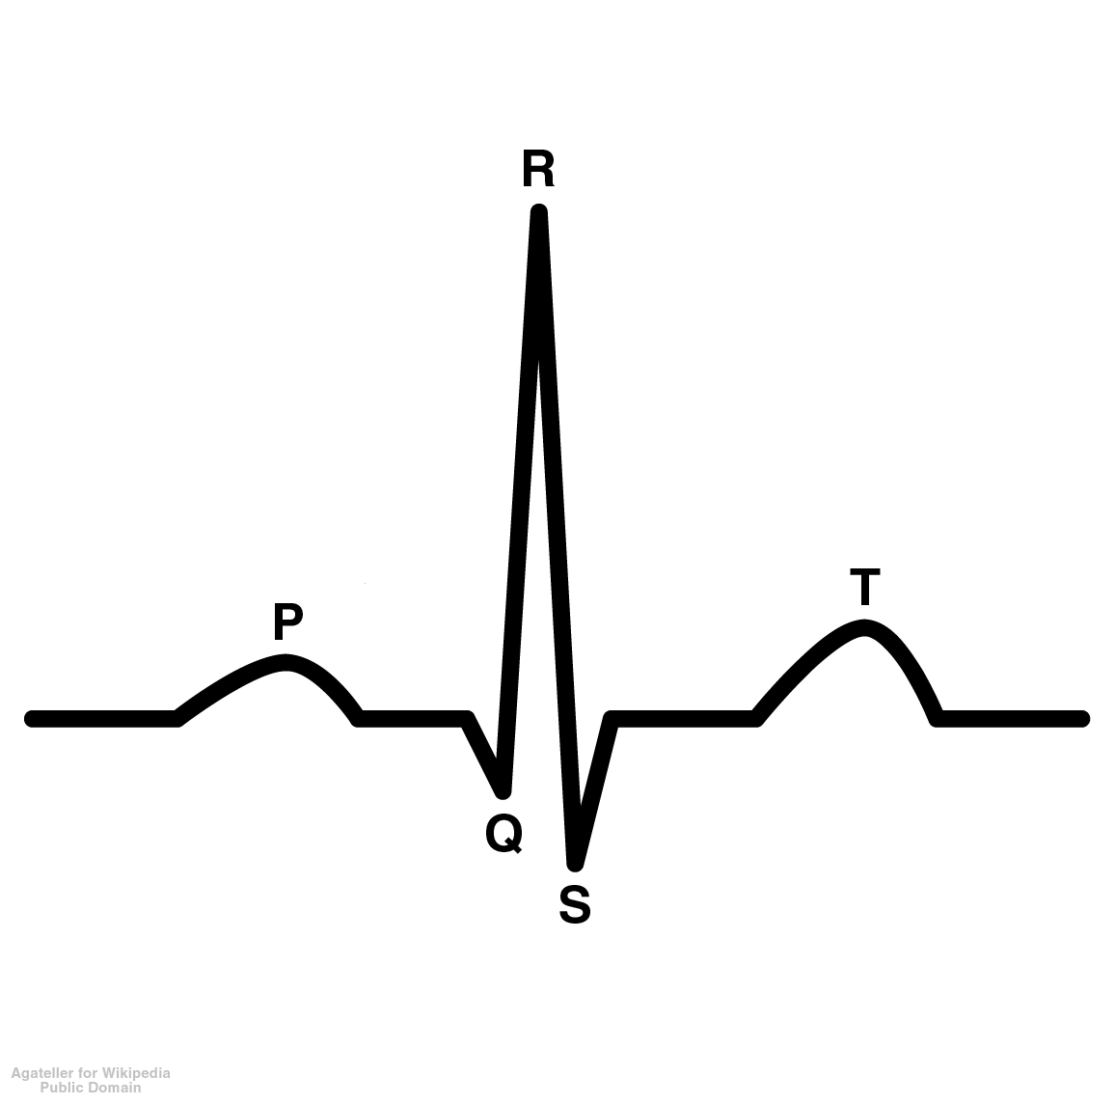
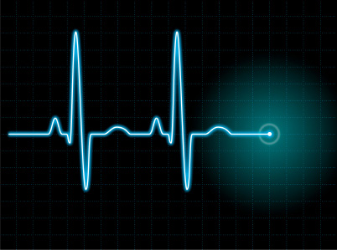
the “waves” of an ECG are lettered P through T
P wave= squeezing of the atria
QRS complex= relaxing of atria and squeezing of ventricles
T wave= relaxing of ventricles, heart back to rest

Slide 22
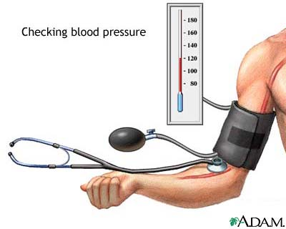
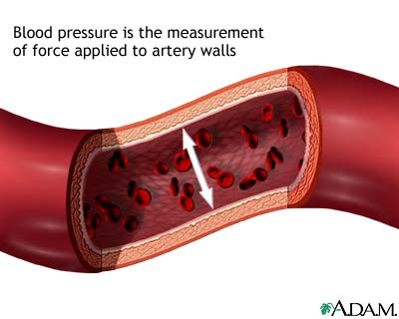
Blood Pressure-
Blood Pressure- pressure of blood pushing on vessel walls
Systolic= pressure when heart ventricles squeeze
Diastolic= pressure when heart is at rest
Avg. B.P.=120/80
Pressure is HIGHEST in aorta and major arteries
Pressure is very LOW in veins= <10 mmHg

Slide 23
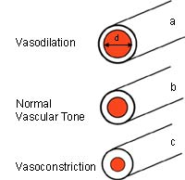
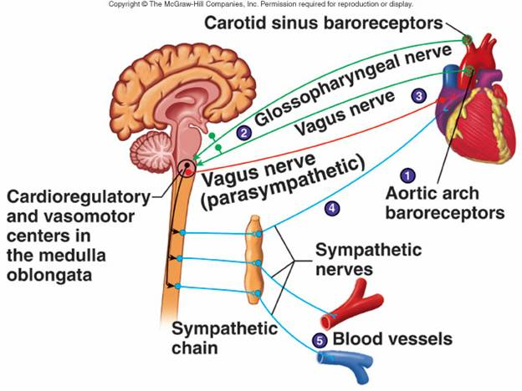
Regulation of Blood Pressure:
Arteries can dilate or constrict to regulate pressure
(achieved by smooth muscles surrounding the vessel)
Heartrate may change to regulate pressure

Slide 24
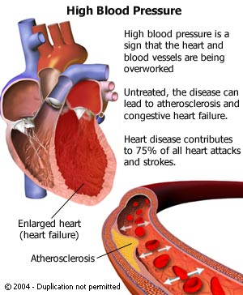
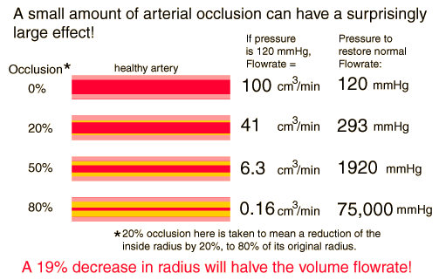
High b.p.=may be caused by narrowing &/or hardening of the arteries (atherosclerosis)

