Slide 1
Ten characteristics of Life
(according to your anatomy text book)

Slide 2
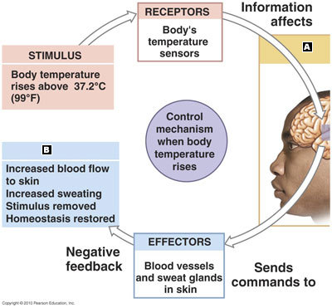
1. Responsiveness to environmental stimuli
(maintaining homeostasis)

Slide 3
2. Conductivity
(ability to transmit a chemical or electrical signal within the organism)

Slide 4
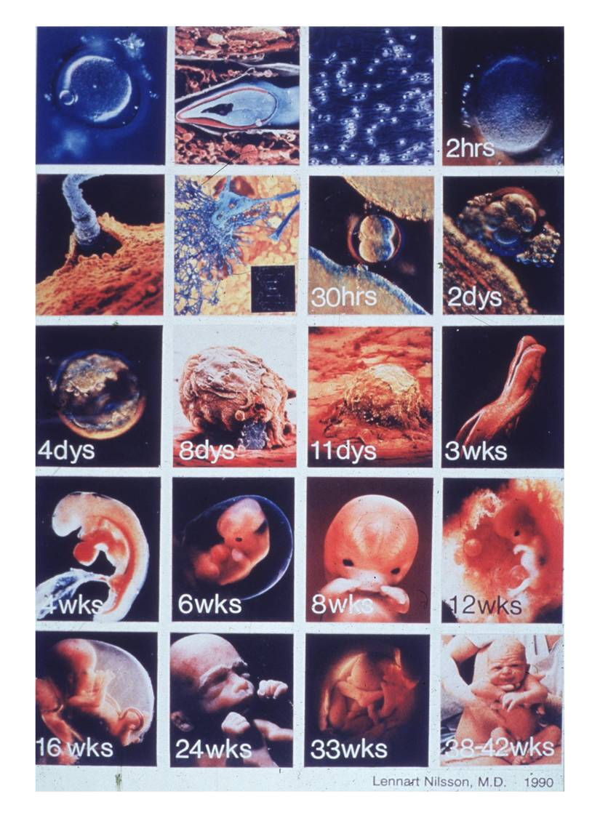
3. Growth
(and development)

Slide 5
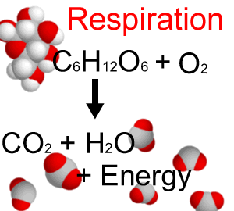
4. Respiration
(exchange of O₂ and CO₂)

Slide 6
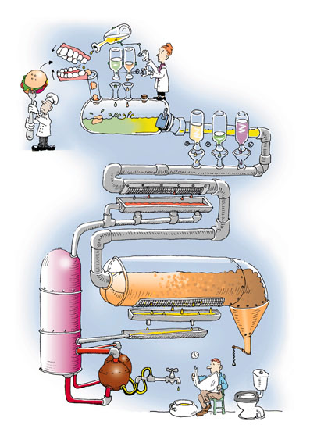
5. digestion
(break down food energy)

Slide 7
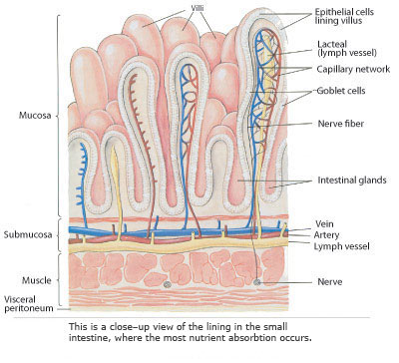
6. absorption
(food nutrients to ALL cells)

Slide 8
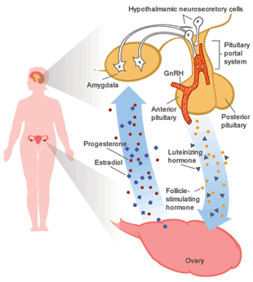
7. secretion
(production and delivery of specialized chemicals)

Slide 9
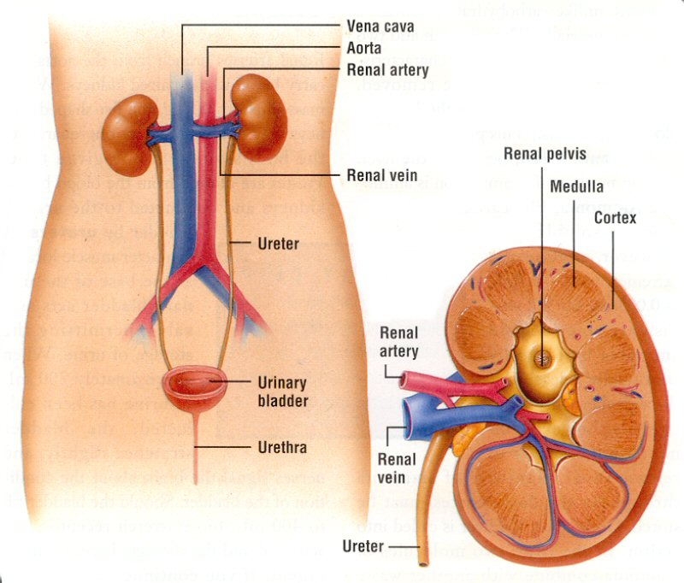
8. excretion
(removal of waste)

Slide 10
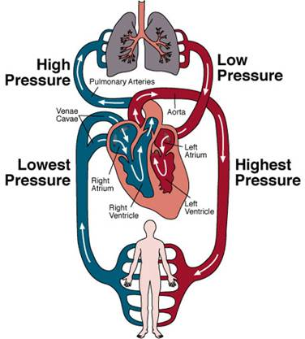
9. circulation

Slide 11
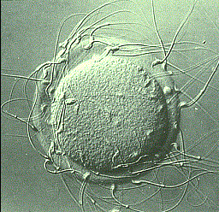
10. reproduction

Slide 12
11 Body Systems (see pg. 8-12)
Integumentary (skin)
Skeletal
Muscular
Nervous
Endocrine (glands and hormones)
Cardiovascular (circulatory)
Lymphatic (immune)
Respiratory
Digestive
Urinary (excretory)
Reproductive

