Slide 1
Muscular System

Slide 2
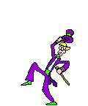
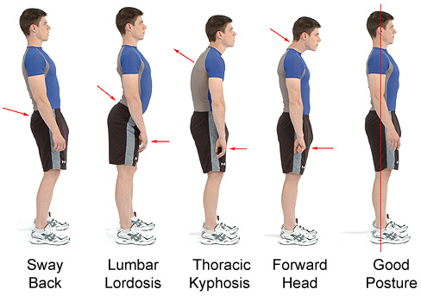
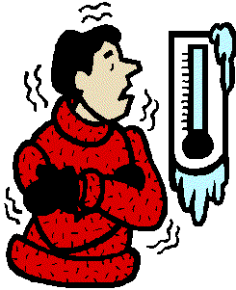
General Functions:
Movement
Posture
Heat Production
(shivering)

Slide 3
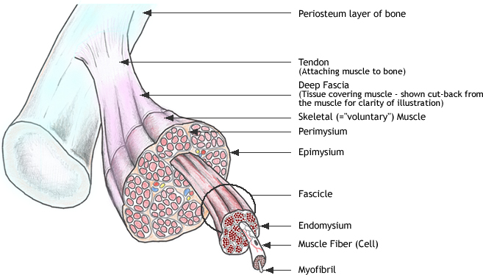
Levels of Muscle Structure
Muscle
↓
Fascicles
↓
Muscle Fibers (cells)
↓
Myofibrils
↓
Sarcomeres
↓
Myofilaments (actin and myosin)

Slide 4
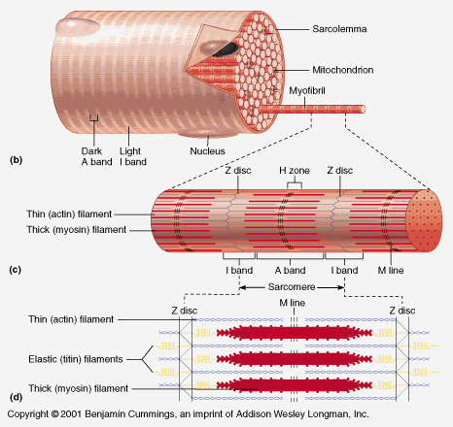
Microscopic anatomy of Striated Muscle:
- A muscle cell is also often called a muscle fiber – VERY long, VERY thin, multinucleate
- a muscle fiber has many tiny parallel fibers called myofibrils
- a myofibril is a long lineup of many contractile units called sarcomeres
a muscle fiber (muscle cell)

Slide 5
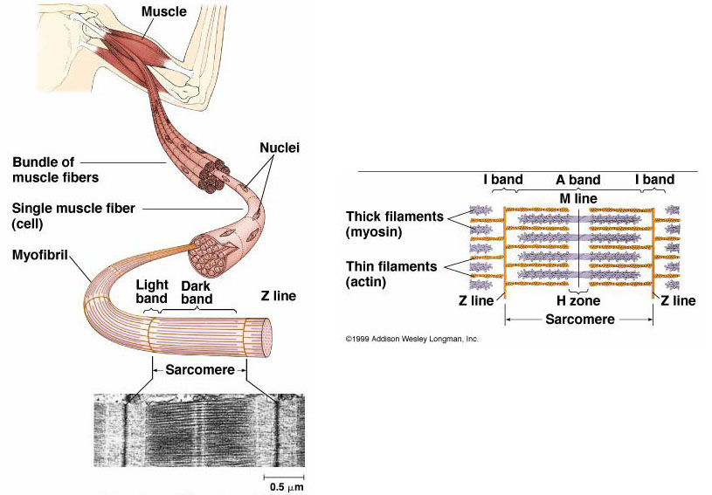
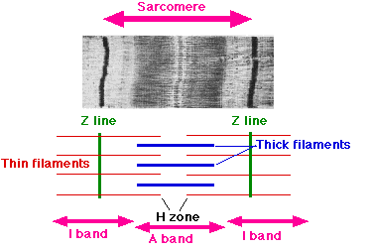
Sarcomeres
made of thousands of
“intermeshed” thick and
thin myofilaments
Thin filaments contain
the active protein actin
Thick filaments
contain the protein myosin
Thick and thin
filaments give muscle the striated appearance
Dark bands=thick & thin filaments “the A band”
Light bands= only thin filament “the I band”
Ends of sarcomeres “the Z line”

Slide 6
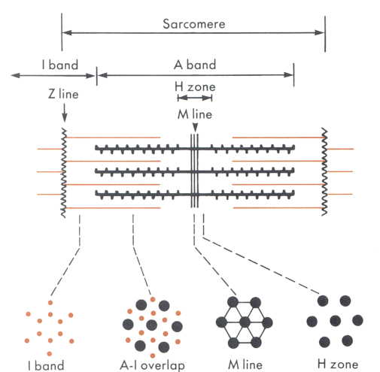
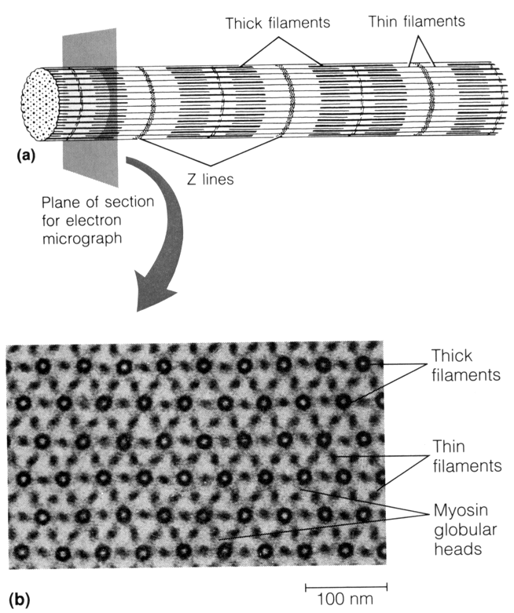
Sarcomere cross-sectional view

Slide 7
Contraction of a Sarcomere:
a NERVE IMPULSE at the nerve/muscle synapse releases acetylcholine
stimulation of acetylcholine receptors in muscle cell membrane causes the muscle cell to release Ca++ ions form the sarcoplasmic reticulum (SR)
the Ca++ stimulates many reactions per second between actin and myosin in the thin and thick filaments (actin & myosin bind)
thin and thick filaments slide past each other causing the muscle to shorten
- this requires energy from ATP that is present in muscle cell
(From cell respiration: Glucose + oxygen→ ATP + CO₂)

Slide 8
Relaxation
-When nerve impulses are over, Ca++ is pumped back into SR
-actin & myosin are no longer bound together
-thin and thick filaments slide back to their original position

Slide 9
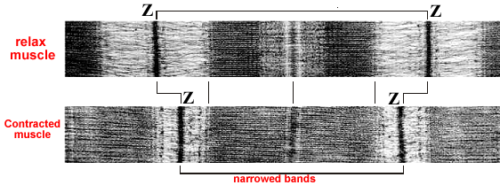

Slide 10
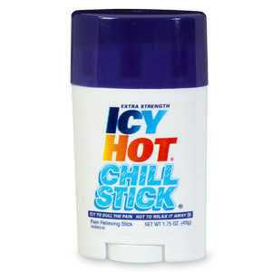
Respiration in Muscle Cells-
Aerobic (presence of plenty of oxygen):
1 Glucose → 38ATP + CO₂
ATP= the major energy currency of the cell, used in most energy consuming activities of the cell
Anaerobic (no oxygen):
1 Glucose → 2ATP + lactic acid (ouchie!)
very inefficient (only 2 ATP) and lactic acid causes muscle soreness

Slide 11
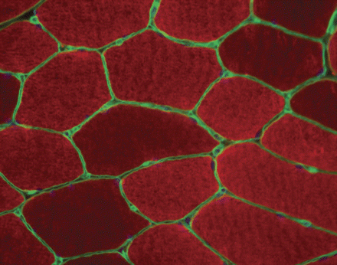
Types of Muscle Fibers-
Slow Twitch- “red fibers”
-contain myoglobin for oxygen storage
-used for aerobic endurance type activities
Cross-section of muscle fibers

Slide 12
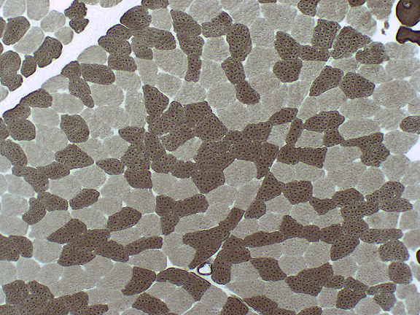
Fast Twitch Muscle- “white fibers”
-very little myoglobin
-for short bursts of power
Intermediate Muscle-
- contain both red and white fibers
- most common in the body
White fibers
red fibers

Slide 13
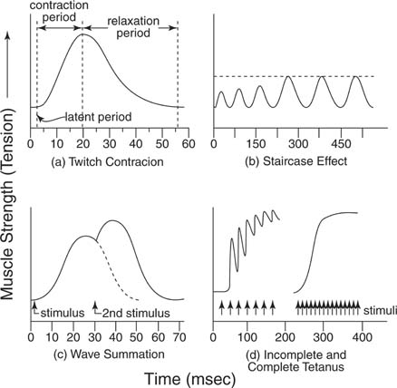
Muscle Contractions-
All or none principle- when a single fiber (cell) is stimulated to threshold, it will contract with max force possible
Contractions can be graphed in a myograph – (see examples)

Slide 14
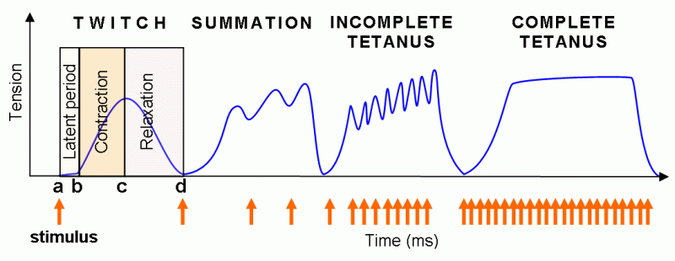
Twitch: single contractions only last a fraction of a second!
Treppe: “staircase phenomenon” contractions get stronger as muscle warms up.
Tetanus: stimuli are rapid enough to sustain a contraction may be incomplete (quivering) or complete.
Fatigue: muscle not able to respond to ANY stimulus (no ATP)
Muscle tone: low level contraction in awake person (maintains
posture)

Slide 15
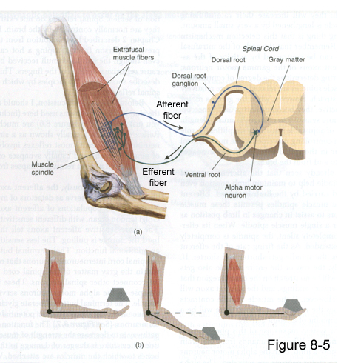
Graded Strength Principle-
As you lift a heavy object, more and more muscle fibers are “recruited” to resist stretching of the muscle until the load is matched.
-called stretch reflex
(negative feedback loop)
- prevents wasting energy
and using more muscle
than needed.

Slide 16
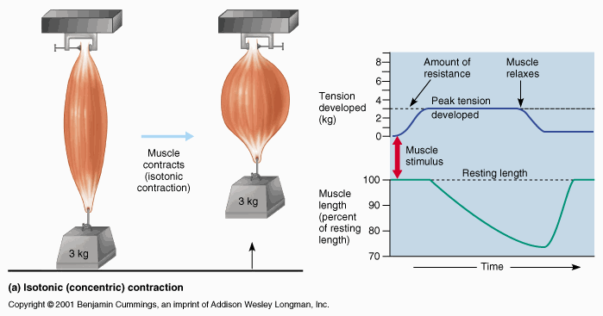
Isotonic vs. Isometric contractions-
Isotonic- muscle tension constant & muscle shortens (movement)

Slide 17
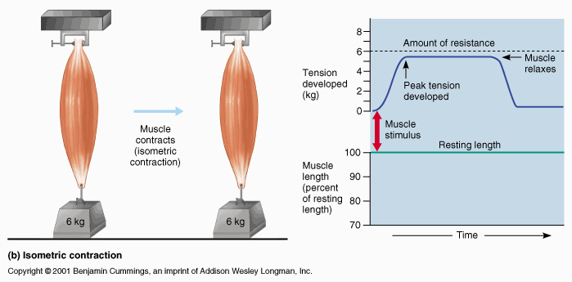
Isometric- tension increases but muscle can’t shorten (load too heavy)

