Slide 1
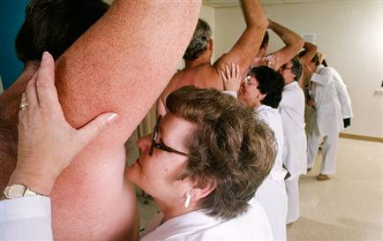
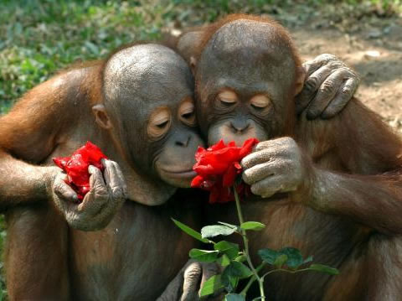
Chemosense: Smell and Taste

Slide 2
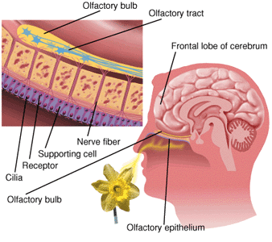
Smell-
-sensed by chemoreceptors in the olfactory epithelium (found at the TOP of nasal cavity)
-smell chemoreceptors are unique nerve cells because they are constantly replaced
-odorants are dissolved in moist mucous membrane before they are smelled. We have about 350 different types of odor receptors!

Slide 3
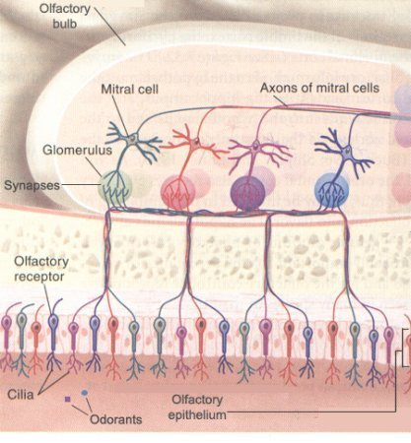
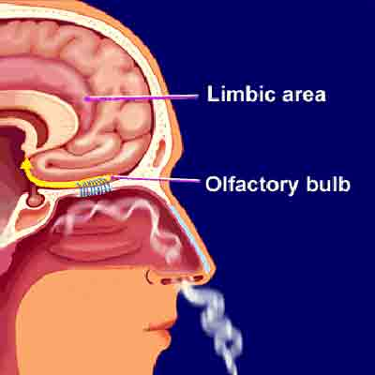
-olfactory receptors pass through the cribiform plate of the skull to the olfactory bulb of the brain lying directly above.
-odor receptors fatigue quickly so we “get used” to smells
-smells interpreted in limbic system of brain (controls mood and is closely related to memories)

Slide 4
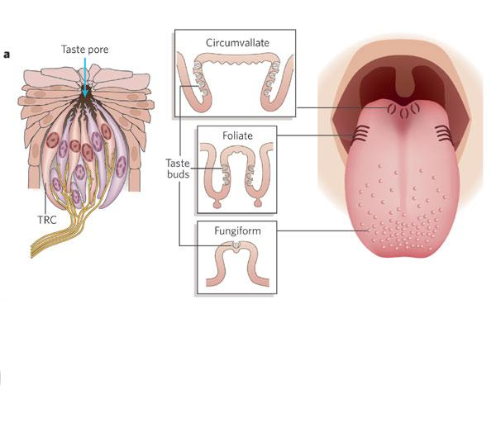
Taste-
-The taste buds respond to gustatory (taste) info.
-each taste bud contains 50-125 gustatory cells
-they are found on the papillae (tiny bumps) on tongue

Slide 5
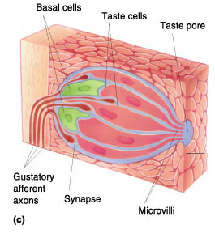
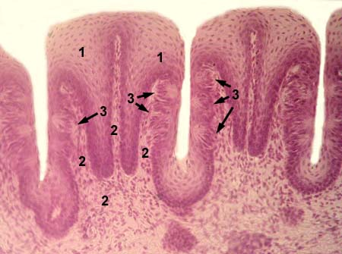
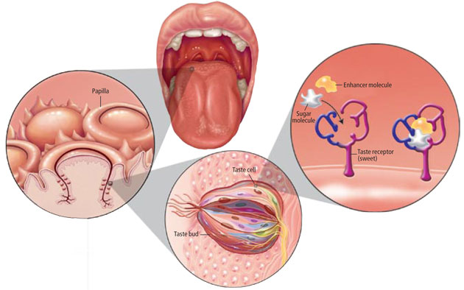
-chemicals must dissolve in saliva before they bind to receptors on taste buds and are tasted

Slide 6
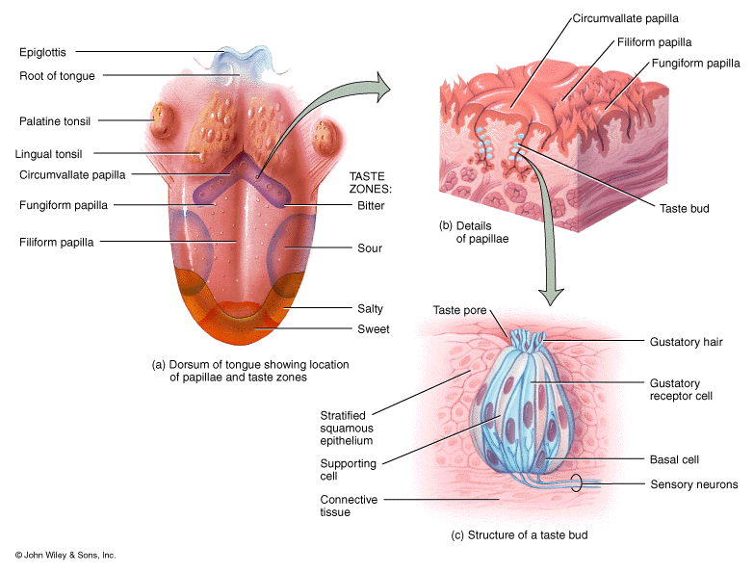
-each taste bud responds to one of 4 (or 5?) primary tastes:
-Bitter
-Sour
-Sweet
-Salty
-Umami (meaty)

Slide 7
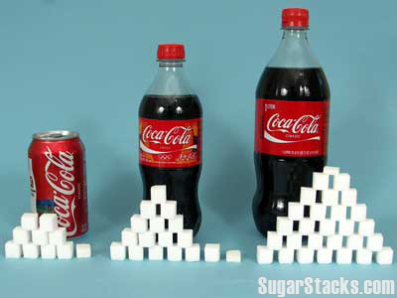
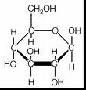
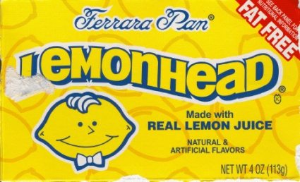
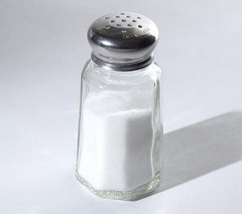
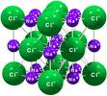
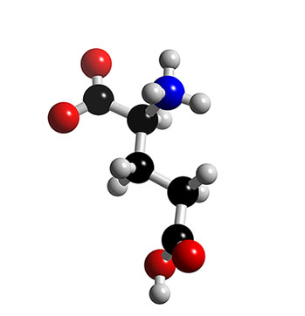
The 5 tastes:
Sweet = simple sugars
Sour = acids (unripe fruit?)
Bitter = base (poison)
Salty = salts
Umami (savory) = amino acids (glutamic acid)

Slide 8
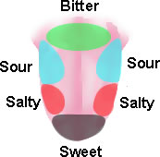
TASTE MAP
no
- There is NO SUCH THING as a taste map!!! Different tastes can be sensed in all areas of the tongue. (though not the same for all people)

Slide 9
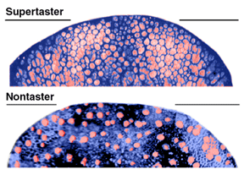
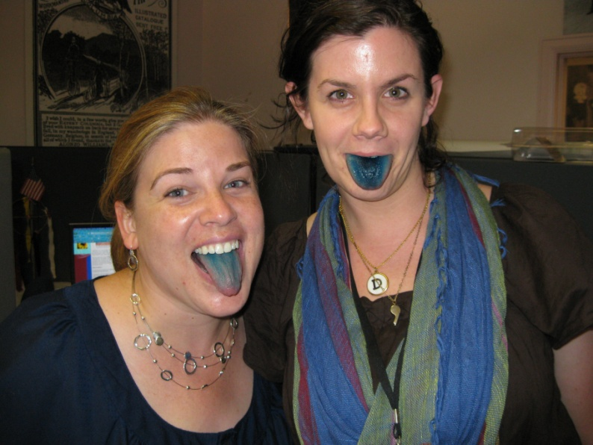

Slide 10
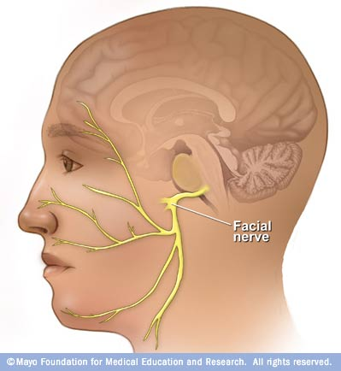
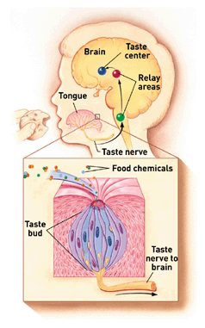
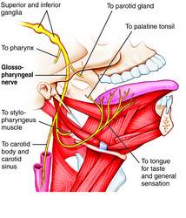
-Taste is interpreted in parietal lobe of cerebral cortex
-Facial & Glossopharyngeal nerves carry taste info

Slide 11
